Slide 1
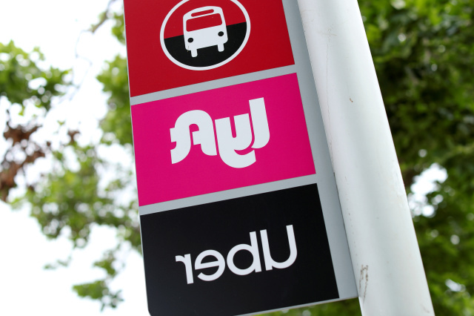
Lyft vs. Uber
Explaining Cab Prices Using Weather Conditions
DROMB8114: Applied Regression Analysis
Group Members:
Anunay Sanganal
Bihui Sun
Haoran Sun
Sarthak Tiwari
Skand Upmanyu
Youngkeun Yoon
Notes:
The concept of ridesharing
Interested in finding out:
how is the pricing algoirithm of Lyft and Uber different from each other
how weather plays a role in determining the price

Slide 2
Overview
Introduction and Data Collection

Slide 3

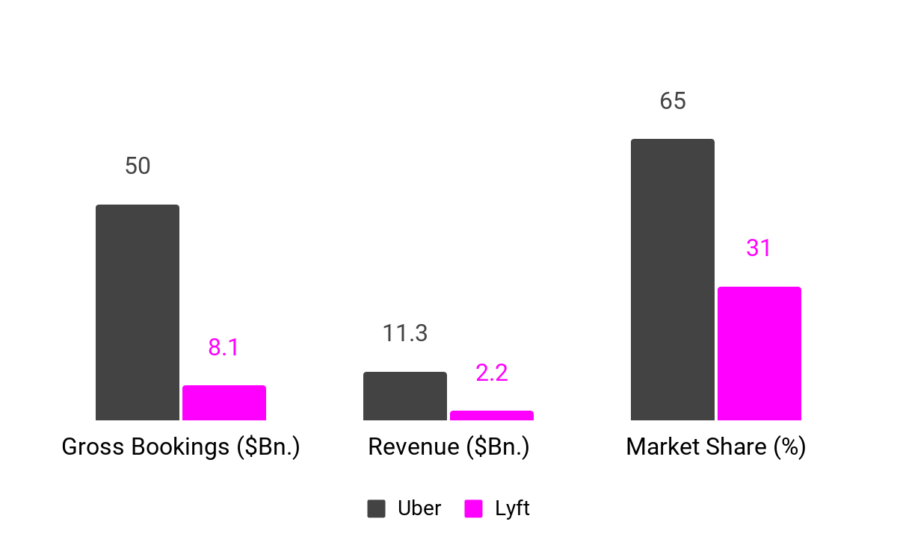





Battle of Rideshare Companies: Uber’s Success
What are the Reasons for Uber’s success?
Key Performance Metrics for Uber and Lyft (2018)
Source: https://www.statista.com/chart/17261/lyft-vs-uber/
‹#›
Notes:
Uber has been outperforming Lyft in terms of bookings, revenue, and market share.
There is also enough support on news and media that in the battle of Lyft and Uber, the clear winner is Uber.
We are interested in finding out what are the reasons for Uber’s success?

Slide 4

Framing the Right Questions
Using Cab Rides data to answer the following questions
What are the reasons for the success of Uber over Lyft?
Is there an overall difference in the cab prices of Uber and Lyft?
If yes, which one is more economical?
Is the difference statistically significant?
How does weather play a role in the pricing of cab rides?
Is the effect of weather conditions different for Uber and Lyft?
In order to help a customer to achieve the lowest price for cab rides, what should be the recommendations?
‹#›
Notes:
Here are some questions that we are interested to answer with the use of data and analytics

Slide 5
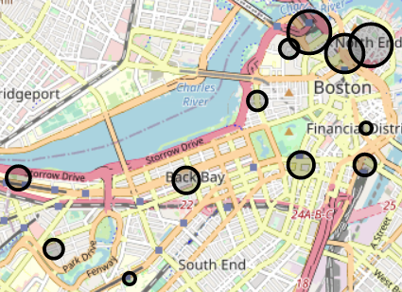
Collecting Data for Cab Rides and Weather Conditions
Data Collection Approach
With no publicly available data of rides/prices, the data was collected using Uber & Lyft API queries and corresponding weather conditions. Some of the hot locations in Boston (MA) were chosen:
1. Haymarket Square 7. Fenway
2. Back Bay 8. South Station
3. North End 9. Theatre District
4. North Station 10. West End
5. Beacon Hill 11. Financial District
6. Boston University 12. Northeastern University
An automated application makes a query to the Uber and Lyft API to find out the price of all types of cab rides from location A to B for both Lyft and Uber and also queries the weather conditions at the same time. This helps us to know what the cab prices and the corresponding weather conditions are at the same time. This data is available at:
https://www.kaggle.com/brllrb/uber-and-lyft-dataset-boston-ma
‹#›
Notes:
No publicly available data for the actual rides taken by customers
Find some alternative way
Cab prices are always available on the app for all the locations
Just a matter of saving that data
Chose 12 hot locations in boston and created an application that stores the cab prices between these locations regularly along with the weather conditions

Slide 6



Data Collection Process in Action
Join Data
Lyft API
Weather API
Append Data
Automated Application
making a query every 5 minutes
Join Data
One View Table for Uber, Lyft, and Weather Data
Uber API
Weather API
*One row represents one ride and corresponding weather conditions
‹#›
Notes:
Here’s what the application looks like:
Walk through each steps
An automated application was written in Scala which triggers every 5 minutes
Makes API request to Lyft and Uber to get cab prices for the hot locations in Boston
At the same time makes a request to weather API to get weather data during that time
It joins the data so that one row represents one ride details and corresponding weather
And finally stacks uber and lyft data together to create a single view

Slide 7
Overview of Collected Data
Data Summary
Duration | 26-Nov-2018 to 18-Dec-2018 (not all days covered)
# Days | 17
# Rows | 693,071
# Columns | 56
Data Categories | Timestamp of ride, Cab category, Distance, Temperature, Humidity, UV Index, Precipitation Probability, Wind Speed, Visibility, Pressure etc.
Tool Used for Analysis | Python
Note: One row represents the cab price and weather conditions at a particular timestamp. It does not represent an actual ride taken by the customer. The demand at a particular time is indicated by the price of the cab at that time
‹#›
Notes:
Data collected in Nov and Dec of 2018: Cold weather conditions
17 days
around 700k rides
56 columns which include (examples from categories)
Learned Excel and Minitab in homeworks, wanted to try something different, so went ahead with Python.

Slide 8
Data Exploration
Performing EDA to determine the relationship between features and price
Notes:
We started by exploring the data to find out some initial insights and relationships in the data

Slide 9
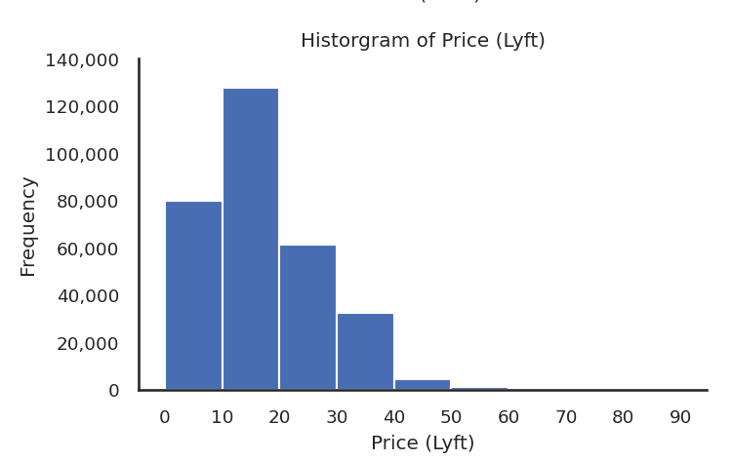
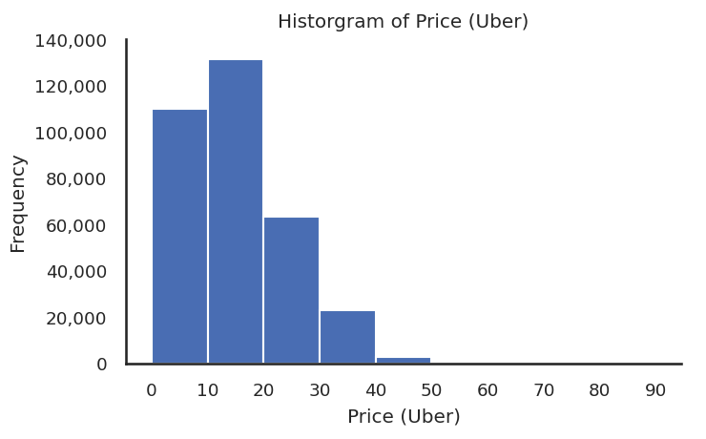
On an Average, Lyft is Priced Lower than Uber
Univariate: Price of Cab Ride
Mean = $17.35
Mean = $15.79
Is this difference statistically significant?
‹#›
Notes:
We started with some univariate analysis
Price of Uber seems to be significantly lower than that of Lyft.
Looks like Uber’s response has been it competitive pricing over Lyft
To confirm this, we’ll have to check if the difference is statistically significant

Slide 10
Lyft Prices are Significantly Lower Priced than Uber
F-Test: Single Factor ANOVA for Cab Company
Hypotheses:
H₀: There is no difference in the average price
by cab company
H_{a}: There is difference in the average price by cab company
SUMMARY
Groups | Count | Sum | Average | Variance
Lyft | 307408 | 5333957.98 | 17.35 | 100.38
Uber | 330568 | 5221435.00 | 15.80 | 73.28
ANOVA
Source of Variation | SS | df | F | P-value
Between Groups | 385674.02 | 1 | 4466.96 | 0.00
Within Groups | 55082209.36 | 637974
Total | 55467883.37 | 637975
Since the p-value < 0.05, we reject the Null Hypothesis and conclude that Cab Company is a significant feature for differentiating the price of the cab ride
One possible reason for Uber’s success can be its significantly lower price
‹#›
Notes:
Performed an F-Test to test if the difference in the price of Lyft and Uber and statistically significant
Explain hypotheses
Found large F value and very low p-value
Since the p-value < 0.05, we reject the Null Hypothesis and conclude that Cab Company is a significant feature for differentiating the price of the cab ride
One possible response of Uber to Lyft’s success can be its significantly lower price

Slide 11
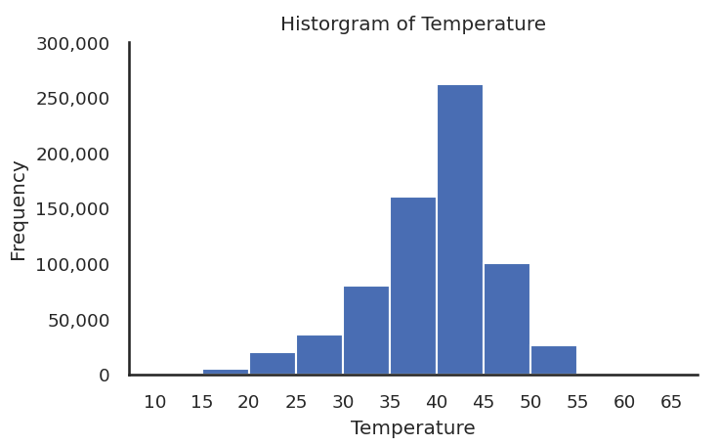
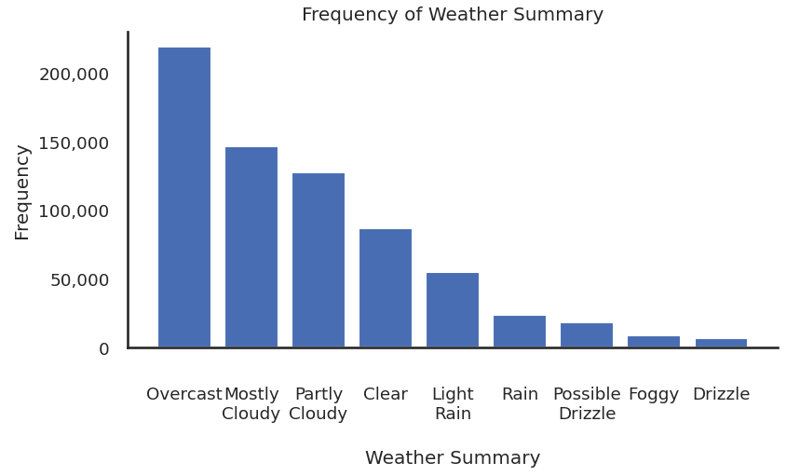
Cold Weather Conditions with less Sunlight in Winter in Boston, MA
Univariate: Temperature and Weather Conditions
Mean = 39.58 °F
Cold Weather Conditions
Mostly Overcast/Cloudy
‹#›
Notes:
Now, if we look at weather conditions in Boston, it is pretty cold with an average of 40 degrees as it is the months of November and December
Also, the weather conditions indicate that the weather is mostly cloudy and overcast

Slide 12
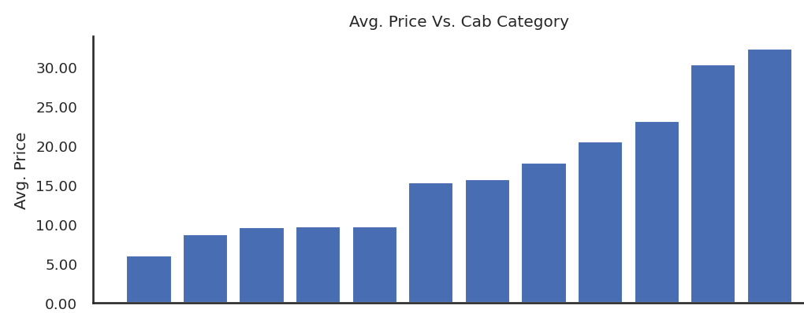
Lyft Covers a Broad Spectrum of Low Priced to High Priced Options
Bivariate: Avg. Price Vs. Cab Category
Shared
Uber
Pool
Lyft
WAV
UberX
Lyft
XL
UberXL
Lux
Black
Lux
Black
Black
SUV
Lux
Black
XL
Cab Category
‹#›
Notes:
Among all the options we have for booking a ride, this graph indicates the average price of each of them
Interestingly, the lowest and the highest prices are both by Lyft
It would also be interesting to check if the difference in price among these cab categories are statistically significant
(Since the same rides are being tracked again and again, it is okay to look at the average price)

Slide 13
Cab Category is Significant for Determining Price
F-Test: Single Factor ANOVA for Cab Category
Hypotheses:
H₀: There is no difference in the average price
by cab category
H_{a}: There is difference in the average price by cab category
SUMMARY
Groups | Count | Sum | Average | Variance
Black | 55095 | 1130758.00 | 20.52 | 24.52
Black SUV | 55095 | 1668679.50 | 30.29 | 23.39
... | ... | ... | ... | ...
ANOVA
Source of Variation | SS | df | F | P-value
Between Groups | 46848473.37 | 12 | 198877.84 | 0.00
Within Groups | 12523449.45 | 637964
Total | 59371922.82 | 637976
Since the p-value < 0.05, we reject the Null Hypothesis and conclude that Cab Category is a significant feature for differentiating the price of the cab ride
Note: Other categorical variables were also tested but turned out to be insignificant (refer Appendix)
‹#›
Notes:
Performed an F-Test to test if the difference in the price of different cab categories and statistically significant
Explain hypotheses
Found large F value and very low p-value
Since the p-value < 0.05, we reject the Null Hypothesis and conclude that Cab Category is a significant feature for differentiating the price of the cab ride

Slide 14
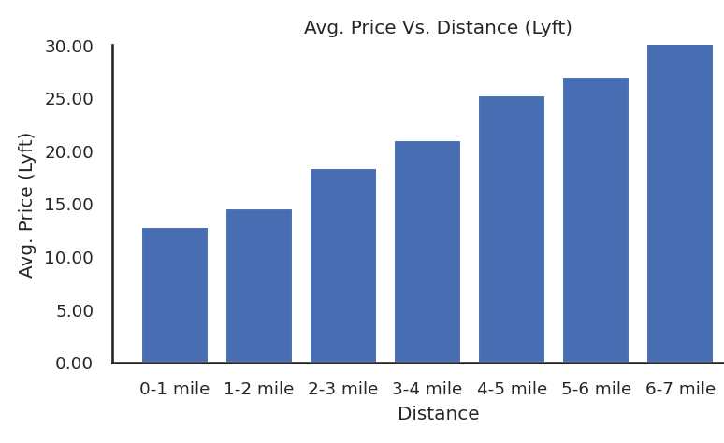
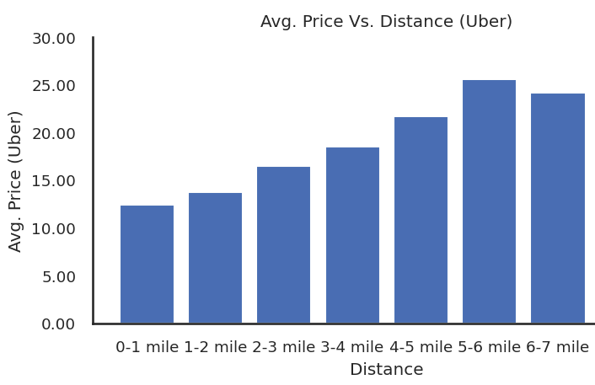
Uber is More Economical for Long Distance Rides
Bivariate: Avg. Price vs. Distance
$ 6.2
‹#›
Notes:
Explain axes
Price of Lyft increases consistently with increase in distance
Moreover, the rate of increase in price with distance seems to be higher for Lyft as compared to Uber indicating that Uber is more economical for long distance rides

Slide 15
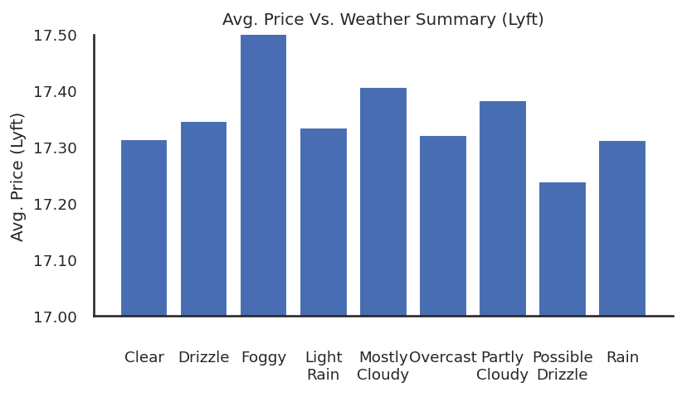
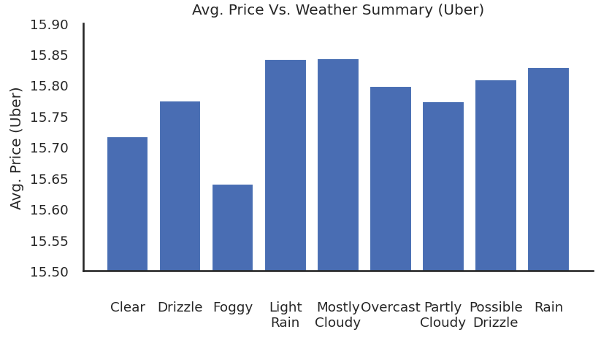
Lyft Prices Peak during Fog and Uber Prices Peak During Rains
Bivariate: Avg. Price vs. Weather Summary
‹#›
Notes:
Lyft prices peak during foggy weather when there is less visibility
Uber prices are mostly consistent. Although slightly higher priced during rains

Slide 16
Regression Modeling
Regression models to determine the price of a cab ride using ride data and weather data
Notes:
Carried out regression modeling for explaining the price of Uber and Lyft using trip details and weather conditions

Slide 17
Modeling Framework
Data Import
Imported CSV data into Python for data preparation
Missing Value Treatment
Dropped rows with missing values as we have a large dataset
Feature Engineering
Created additional features for modeling (Time from Max Temp., Day of Week, Hour, etc.)
Correlation and VIF Analysis
Removed Correlated Variables and variables with High VIF values
Model Iterations and Variable Selection
Explored Linear and Exponential Regression and selected variables using Forward Selection
Model for explaining price of all cab rides together
Individual model for explaining prices of Lyft rides only
Individual model for explaining prices of Uber rides only
Insights from Model
Selected model with the highest Adj. R Squared and interpreted coefficients to create insights
Regression Diagnostics
Analyzed the residuals for Homoscedasticity and patterns
‹#›
Notes:
Here’s what our modeling framework looks like:
Explain briefly each part

Slide 18
Feature Engineering
Additional Features Created for Modeling
Features from Time of Cab Booking:
Hour
Day of Week
Time Difference between Time of Cab Booking and:
Time of Maximum Temperature during that day
Time of Minimum Temperature during that day
Time of Sunrise during that day
Time of Sunset during that day
One Hot Encoding (Dummy variables) created for categorical features
‹#›
Notes:
Explain briefly on each additional feature

Slide 19
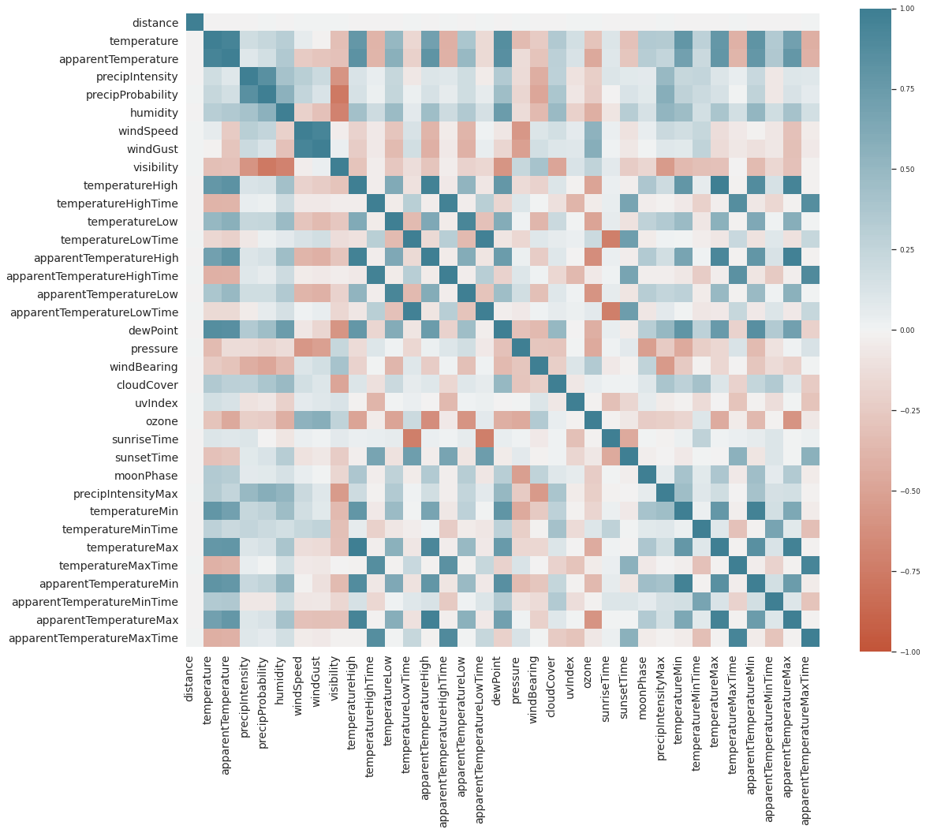
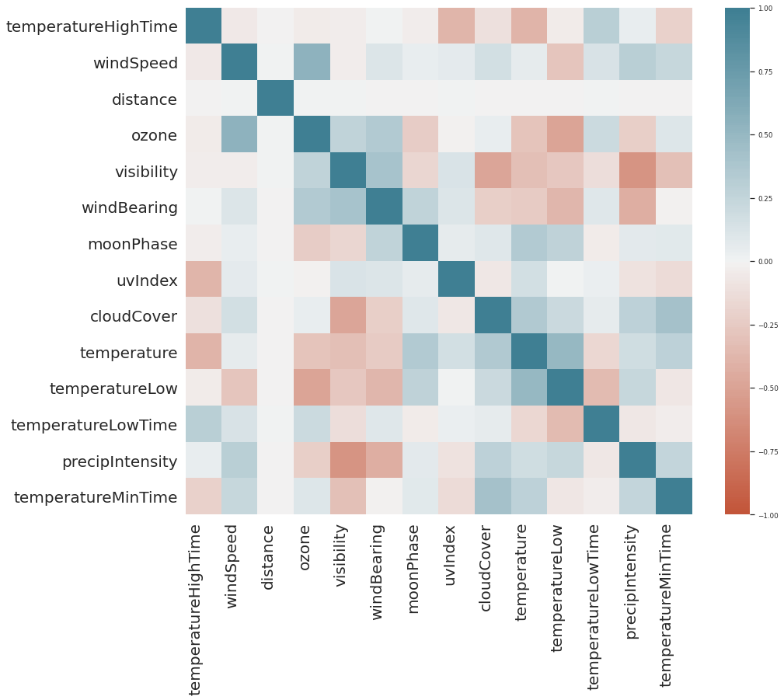
Correlation Analysis (21 variables removed)
Removed variables with High Correlation ( > 0.6 or < -0.6)
‹#›

Slide 20
Correlation Analysis (21 variables removed)
Correlated Variables
Sunset/Sunrise Time correlated with Max Temp. Time and Min. Temp. Time
Apparent Temp. High/Low Time correlated with Temp. High/Low Time
Wind Gust correlated with Wind Speed
Precipitation, Dew Point, Humidity, Visibility, and Pressure all correlated
Temperature, High Temperature, and Low Temperature all correlated
‹#›
Notes:
Sunset and Sunrise are kind of indicative of when the maximum and minimum temperature will occur during winter season
Apparent temperature and actual temperature are correlated as one is indicative of the other
Wind gust is the force of wind and therefore correlated with speed
Similarly for others

Slide 21
VIF Analysis (8 variables removed)
Removed variables with High Variable Inflation Factor ( > 5.0)
Variable | VIF
cab_type_Uber | inf
name_Lux | inf
name_LyftXL | inf
name_Lyft | inf
name_Shared | inf
name_LuxBlackXL | inf
name_LuxBlack | inf
short_summary_Overcast | 46.36
cloudCover | 28.72
short_summary_LightRain | 24.15
short_summary_Rain | 20.22
short_summary_MostlyCloudy | 19.88
precipIntensity | 17.93
temperatureLowTime | 15.25
uvIndex | 10.67
... | ...
Variable | VIF
dayOfWeek_Tuesday | 3.79
dayOfWeek_Monday | 3.14
temperature | 3.13
temperatureLow | 2.73
dayOfWeek_Thursday | 2.51
dayOfWeek_Sunday | 2.51
windBearing | 2.47
windSpeed | 2.36
cloudCover | 2.33
dayOfWeek_Wednesday | 2.30
temperatureMinTime | 2.17
dayOfWeek_Saturday | 2.09
hour_10 | 2.04
hour_11 | 2.03
hour_17 | 2.02
... | ...
‹#›
Notes:
Can talk about cab_type_Uber. Basically, cab company (Uber/Lyft) variable is not required because this can be identified completely using cab category (UberX, UberPool, Lux etc.). That is why cab_Type_Uber has VIF of infinity

Slide 22
Model Iterations (All Cab Rides)
+
Model Iterations
# Rows = 637,976 | v1.0: Full Model | v1.1: Linear Regression with Forward Selection | v1.2: Log(Price), Log(Distance) with Forward Selection
Summary | Full model with all features | Forward selection using all features | Changed price to log(price) and distance to log(distance)
# Features | 56 | 20 | 20
Significant features | 20 | 20 | 20
R² | 0.893 | 0.893 | 0.917
Adj. R² | 0.893 | 0.893 | 0.917
‹#›

Slide 23
Insights from the Proposed Model for All Cab Rides
Regression Statistics
R Square | 0.917
Adjusted R Square | 0.917
+
 | Coefficients | Standard Error | t Stat | P-value
Intercept | 2.7973 | 0.001 | 3260.592 | 0.000
name_UberPool | -0.8521 | 0.001 | -861.067 | 0.000
name_Shared | -1.2671 | 0.001 | -1256.908 | 0.000
name_BlackSUV | 0.4042 | 0.001 | 408.411 | 0.000
name_LuxBlackXL | 0.4550 | 0.001 | 451.39 | 0.000
name_UberXL | -0.2797 | 0.001 | -282.602 | 0.000
name_WAV | -0.7438 | 0.001 | -751.627 | 0.000
name_Lux | -0.1636 | 0.001 | -162.337 | 0.000
name_UberX | -0.7438 | 0.001 | -751.615 | 0.000
name_LuxBlack | 0.1033 | 0.001 | 102.432 | 0.000
name_Lyft | -0.7686 | 0.001 | -762.419 | 0.000
name_LyftXL | -0.3121 | 0.001 | -309.553 | 0.000
log_distance | 0.3169 | 0.000 | 905.318 | 0.000
short_summary_MostlyCloudy | 0.0013 | 0.001 | 2.600 | 0.009
cloudCover | -0.0019 | 0.001 | -3.061 | 0.002
temperatureMinTime | 8.543e-05 | 3.65e-05 | 2.339 | 0.019
hour_13 | 0.0031 | 0.001 | 3.057 | 0.002
hour_17 | 0.0031 | 0.001 | 3.073 | 0.002
hour_20 | 0.0025 | 0.001 | 2.281 | 0.023
hour_21 | 0.0024 | 0.001 | 2.267 | 0.023
hour_2 | 0.0021 | 0.001 | 2.016 | 0.044
Shared Cab is the most economical (Least coefficient)
Lux Black XL is the most expensive (Highest coefficient)
Rate of increase of log(price) with log(distance)
Cloudy Weather leads to increase in Price: Customers prefer cabs in Cloudy weather (due to possibility of rain)
Busy hours: 1:00pm, 5:00pm, 8:00pm, and 9:00pm
Less availability of cabs: 2:00am
‹#›

Slide 24
Model Iterations (Lyft Rides)
Model Iterations
# Rows = 307,408 | v2.0: Full Model | v2.1: Linear Regression with Forward Selection | v2.2: Log(Price), Log(Distance) with Forward Selection
Summary | Full model with all features | Forward selection using all features | Changed price to log(price) and distance to log(distance)
# Features | 56 | 11 | 10
Significant features | 18 | 11 | 10
R² | 0.877 | 0.877 | 0.919
Adj. R² | 0.877 | 0.877 | 0.919
‹#›

Slide 25
Insights from the Proposed Model for Lyft Rides
Regression Statistics
R Square | 0.919
Adjusted R Square | 0.919
 | Coefficients | Standard Error | t Stat | P-value
Intercept | 1.4969 | 0.001 | 1677.051 | 0.000
name_LuxBlackXL | 0.4985 | 0.001 | 447.744 | 0.000
name_Lux | 1.3703 | 0.001 | 1230.807 | 0.000
name_LuxBlack | 1.1034 | 0.001 | 991.076 | 0.000
name_Lyft | 1.7221 | 0.001 | 1546.771 | 0.000
name_LyftXL | 0.9550 | 0.001 | 857.773 | 0.000
log_distance | 0.3684 | 0.001 | 645.495 | 0.000
short_summary_MostlyCloudy | 0.0022 | 0.001 | 2.733 | 0.006
hour_13 | 0.0043 | 0.002 | 2.754 | 0.006
hour_18 | -0.0036 | 0.002 | -2.253 | 0.024
hour_20 | 0.0035 | 0.002 | 2.094 | 0.036
Shared Cab is the most economical
Lux Black XL is the most expensive (Highest coefficient)
Higher Rate of increase with distance: (0.3169 for overall model)
Cloudy weather increasing price due to chances of rain
1:00pm and 8:00pm are busier. However, 6:00pm is the most economical time for Lyft
‹#›

Slide 26
Model Iterations (Uber Rides)
Model Iterations
# Rows = 330,568 | v3.0: Full Model | v3.1: Linear Regression with Forward Selection | v3.2: Log(Price), Log(Distance) with Forward Selection
Summary | Full model with all features | Forward selection using all features | Changed price to log(price) and distance to log(distance)
# Features | 56 | 10 | 11
Significant features | 10 | 10 | 11
R² | 0.920 | 0.920 | 0.918
Adj. R² | 0.920 | 0.920 | 0.918
‹#›

Slide 27
Insights from the Proposed Model for Uber Rides
Regression Statistics
R Square | 0.918
Adjusted R Square | 0.918
 | Coefficients | Standard Error | t Stat | P-value
Intercept | 2.8228 | 0.001 | 3301.083 | 0.000
name_UberPool | -0.8521 | 0.001 | -972.925 | 0.000
name_BlackSUV | 0.4042 | 0.001 | 461.458 | 0.000
name_UberXL | -0.2797 | 0.001 | -319.312 | 0.000
name_WAV | -0.7438 | 0.001 | -849.272 | 0.000
name_UberX | -0.7438 | 0.001 | -849.263 | 0.000
log_distance | 0.2760 | 0.000 | 664.979 | 0.000
temperatureMinTime | 0.0001 | 4.46E-05 | 3.076 | 0.002
cloudCover | -0.0018 | 0.001 | -2.256 | 0.024
hour_17 | 0.0038 | 0.001 | 3.004 | 0.003
hour_2 | 0.0026 | 0.001 | 2.013 | 0.044
hour_1 | -0.0027 | 0.001 | -2.134 | 0.033
UberPool is the most economical option for Uber
BlackSUV is the most expensive option for Uber
Lower Rate of increase with distance: (0.3684 for Lyft)
More demand when away from Temp Min. Time / Night time
Reduced price of Uber during Cloudy weather: Reliability
5:00pm is a busy time for Uber
Fluctuation at Night: 1:00am is the most economical while 2:00am is busy. One possibility being less demand at 1:00am but many drivers heading home after 2:00am reducing cab availability
‹#›

Slide 28
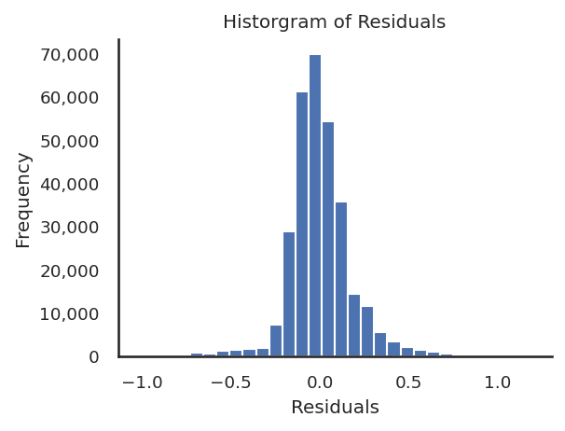
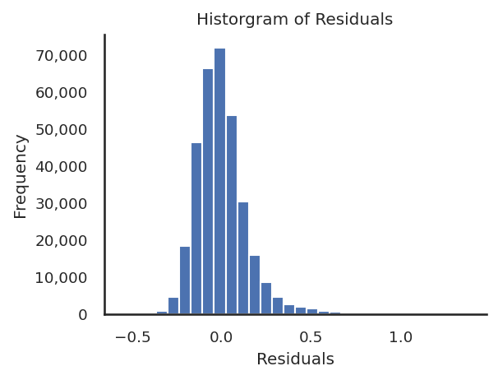
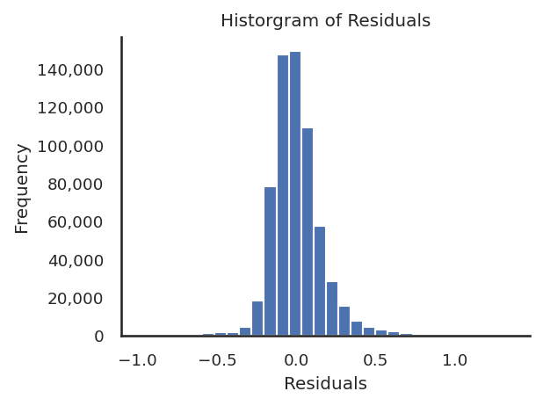
Regression Diagnostics
Distribution of Residuals
Model for All Rides (v1.2)
Model for Lyft Rides (v3.2)
Model for Uber Rides (v3.2)
The distribution of residuals suggests that the residuals are normally distributed
‹#›

Slide 29
Recommendations and Takeaways
Final Recommendations, learnings and scope for improvement

Slide 30

Recommendations for a Consumer to Achieve Lowest Cab Prices
Achieving the Most Economical Options
Uber has a significantly lower price than Lyft
Uber is also more economical for long distance rides
More reliable during bad weather conditions
Consider taking advantage of fluctuation of price around 1:00am - 2:00am at night
However, consider Lyft during the following conditions:
Shared cab of Lyft is even more economical than UberPool
6:00pm is a sweet spot for booking Lyft rides to get home from office. This time is expensive for Uber
Note: Results only applicable to hot areas of Boston, MA. There might be different trends in different geographic locations
‹#›

Slide 31
Learnings from Project and Scope for Improvement
Learnings and Way Forward
Python
Reproducible code and easy to replicate results
Easier for collaboration in a team (Google Colab)
No UI with drag drop features and requires coding background
Google Sheets as a substitute for collaboration but has limited features
Target Variable
Different Target Variables can be considered for analysis:
Price
Price / Distance
Surge Multiplier
Data Background and Research
Important to research about the data collection approach in order to understand the data that we are working with. The number of rides per cab category did not make sense initially
Is this lower price of Uber sustainable?
‹#›
Notes:
Can talk about Google Colab: Free and multiple people can code together in a single notebook
Google Sheets is similar but it does not have all the features of excel
Different target variables could be considered. Here, we considered price but in future, it would be interesting to consider price/distance and surge multiplier also
Data background: Things were a bit weird when we did not know about the data collection process. Were confused about why all cab categories have equal number of rides (one would expect Luxury cab rides to be much less than UberX rides). It only made sense when we researched about the data collection approach
Sustainability: Uber is offering a lower price, but is this sustainable? it will reduce the profits and can run them out of business. It would be interesting to futherinvestigate this

Slide 32
Thank you

Slide 33
Appendix

Slide 34
Day of Week is Almost Significant for Determining Price
Single Factor ANOVA for Day of Week
Hypotheses:
H₀: There is no difference in the price by day of week
H_{a}: There is difference in the price by day of week
SUMMARY
Groups | Count | Sum | Average | Variance
Monday | 114239 | 1884137.85 | 16.49 | 86.20
Tuesday | 115091 | 1909410.80 | 16.59 | 88.06
... | ... | ... | ... | ...
ANOVA
Source of Variation | SS | df | F | P-value
Between Groups | 1008.98 | 6 | 1.93 | 0.07
Within Groups | 55466874.39 | 637969
Total | 55467883.37 | 637975
Since the p-value = 0.07, we can almost reject the Null Hypothesis and conclude that Day of Week is almost a significant feature for determining the price of the cab ride
‹#›

Slide 35
Weather Summary alone is Not Significant for Determining Price
Single Factor ANOVA for Weather Summary
Hypotheses:
H₀: There is no difference in the price by weather summary
H_{a}: There is difference in the price by weather summary
SUMMARY
Groups | Count | Sum | Average | Variance
Overcast | 201429 | 3330651.85 | 16.54 | 86.81
Mostly Cloudy | 134603 | 2233658.63 | 16.59 | 87.89
... | ... | ... | ... | ...
ANOVA
Source of Variation | SS | df | F | P-value
Between Groups | 725.33 | 8 | 1.04 | 0.40
Within Groups | 55467158.05 | 637969
Total | 55467883.37 | 637967
Since the p-value > 0.05, we cannot reject the Null Hypothesis and conclude that Weather Summary alone is not a significant feature for determining the price of the cab ride
‹#›

Slide 36
Hour of Cab Ride alone is Not Significant for Determining Price
Single Factor ANOVA for Hour
Hypotheses:
H₀: There is no difference in the price by hour of cab ride
H_{a}: There is difference in the price by hour of cab ride
SUMMARY
Groups | Count | Sum | Average | Variance
0 | 29872 | 495121.50 | 16.57 | 87.69
1 | 26310 | 434477.50 | 16.51 | 87.12
... | ... | ... | ... | ...
ANOVA
Source of Variation | SS | df | F | P-value
Between Groups | 898.61 | 23 | 0.45 | 0.99
Within Groups | 55466984.76 | 637952
Total | 55467883.37 | 637975
Since the p-value > 0.05, we cannot reject the Null Hypothesis and conclude that Hour of Cab Ride alone is not a significant feature for determining the price of the cab ride
‹#›

Slide 37
Final Selected Variables
hour_6
hour_13
dayOfWeek_Tuesday
moonPhase
hour_22
cloudCover
temperature
hour_9
short_summary_Rain
name_UberPool
dayOfWeek_Thursday
short_summary_Drizzle
hour_3
name_Shared
windBearing
dayOfWeek_Saturday
temperatureMinTime
dayOfWeek_Monday
short_summary_PartlyCloudy
name_BlackSUV
hour_17
name_LuxBlackXL
short_summary_PossibleDrizzle
distance
dayOfWeek_Wednesday
hour_14
hour_12
short_summary_Foggy
temperatureLow
hour_15
hour_7
name_UberXL
windSpeed
hour_5
name_WAV
price
short_summary_LightRain
short_summary_MostlyCloudy
name_Lux
name_UberX
hour_21
name_LuxBlack
dayOfWeek_Sunday
hour_4
hour_10
hour_8
name_Lyft
hour_20
hour_18
hour_11
name_LyftXL
hour_23
hour_2
hour_16
hour_1
hour_19
‹#›

Slide 38
Variables Removed due to high correlation
temperatureMaxTime
temperatureMax
precipProbability
humidity
pressure
precipIntensityMax
dewPoint
temperatureHigh
temperatureMin
apparentTemperatureMinTime
sunsetTime
sunriseTime
apparentTemperatureHighTime
apparentTemperatureMaxTime
apparentTemperatureLowTime
apparentTemperature
apparentTemperatureLow
apparentTemperatureMin
apparentTemperatureHigh
apparentTemperatureMax
windGust
‹#›

Slide 39
Variables Removed due to high VIF
cab_type_Uber
short_summary_Overcast
precipIntensity
temperatureLowTime
uvIndex
ozone
visibility
temperatureHighTime
‹#›

Slide 40
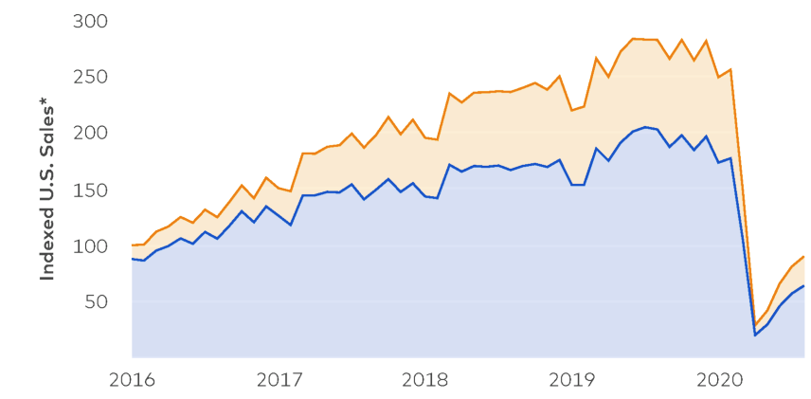
Market Share
Market Share
Monthly Sales for Uber and Lyft in the U.S.
COVID-19:
Work From Home
August 2020
Lyft 29%
Uber 71%
Source: https://secondmeasure.com/datapoints/rideshare-industry-overview/
‹#›
Notes:
Uber has been in the market since 2009
Lyft entered in 2012 and has been stealing Uber’s market share continuously.
We are interested in finding out if Uber has responded to this situation.

Slide 41
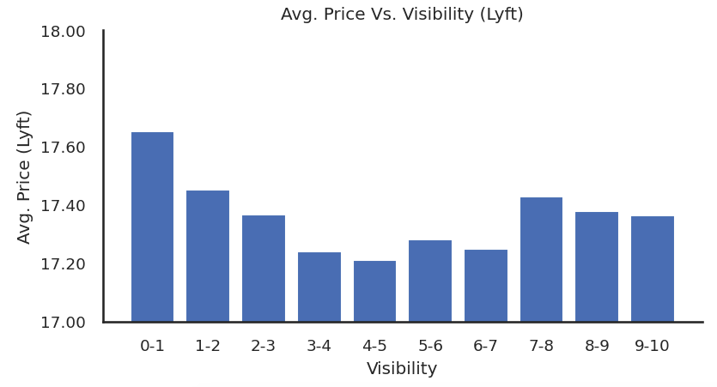
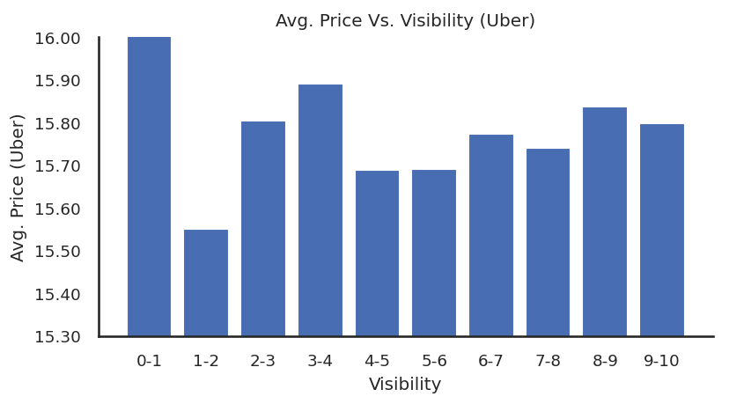
Visibility Plays an Important Role for Lyft but not so much for Uber
Bivariate: Avg. Price vs. Visibility
Price decreasing with Increase in Visibility
Not a Clear Pattern of Price with Visibility
‹#›
Notes:
(Potential to move to appendix)
Lyft prices increase when there is less visibility
Uber prices are mostly agnostic to visibility

Slide 42
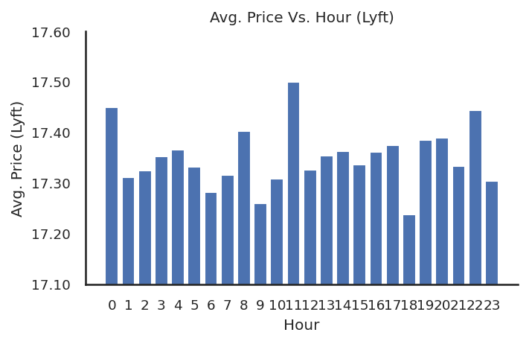
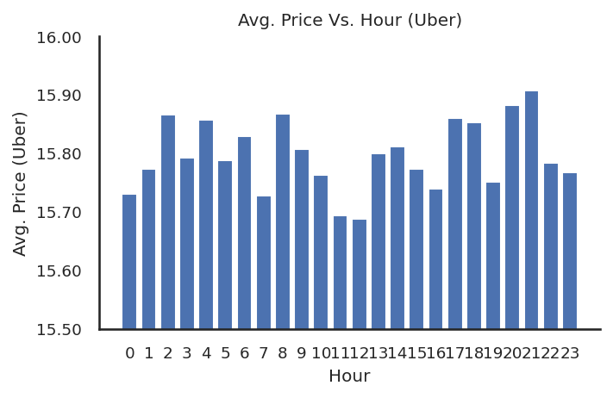
Price plateaued at noon for Uber and no clear pattern for Lyft
Bivariate: Avg. Price vs. Hour
No clear pattern, but price spiked at 11am, 10pm, 0am
Price drops approaching noon before picking up again
‹#›
Notes:
(Potential to move to appendix)
Lyft: No clear pattern, but price spiked at 11am, 10pm, 0am
Uber: Price drops approaching noon before picking up again

Slide 43
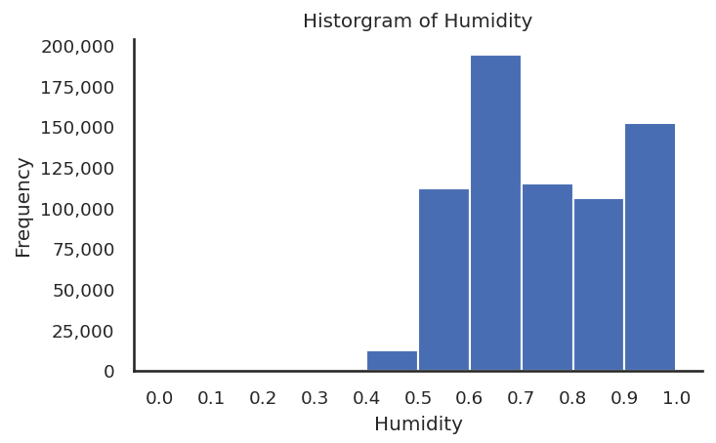
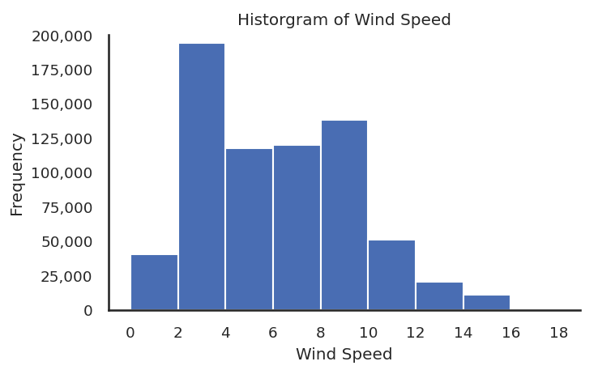
High Humidity and Wind Speed in Winter in Boston, MA
Univariate: Humidity and Wind Speed
Mean = 0.74
Mean = 6.19 mph
‹#›
Notes:
(Potential to move to appendix) the humidity and wind speed is also high causing the weather to be pretty harsh during this season.

